Slide 1

IE 260 – ENGINEERING ECONOMY Chapter 4 The Time Value of Money - II
U. MAHİR YILDIRIM

Slide 2
Previously on IE 260
Simple Interest
Compound Interest
The Concept of Equivalence
Notation and Cash-Flow Diagrams and Tables
Relating Present and Future Equivalent Values of Single Cash Flows
Finding F when Given P
Finding P when Given F
Finding the Interest Rate Given P, F, and N
Finding N when Given P, F, and I
Annuities

Slide 3
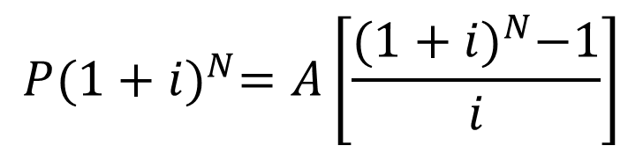

Annuity Finding P when Given A
$F=P{(1+i)}^{N}$
$F=A\left[\frac{{(1+i)}^{N}−1}{i}\right]$
$P=A\left[\frac{{(1+i)}^{N}−1}{i{(1+i)}^{N}}\right]$
$P=A$($P$/$A$, $i$%, $N$)
$$P{(1+i)}^{N}=A\left[\frac{{(1+i)}^{N}−1}{i}\right]$$
uniform series present worth factor

Slide 4
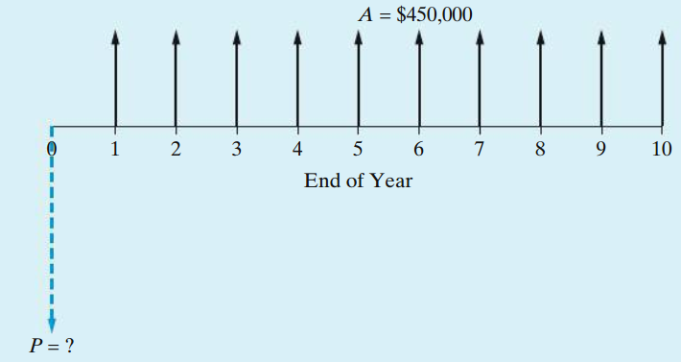
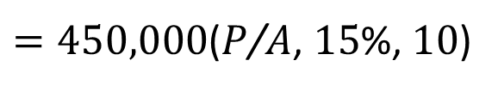
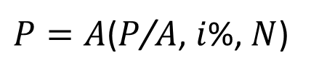
Solution Present Equivalent of an Annuity (Uniform Series)
A micro-brewery is considering the installation of a newly designed boiler system that burns the dried, spent malt and barley grains from the brewing process. The boiler will produce process steam that powers the majority of the brewery’s energy operations, saving $450,000 per year over the boiler’s expected life of 10 years. If the interest rate is 15% per year, how much money can the brewery afford to invest in the new boiler system?
$P=A$($P$/$A$, $i$%, $N$)
$=450,000$($P$/$A$, $15$%, $10$)

Slide 5
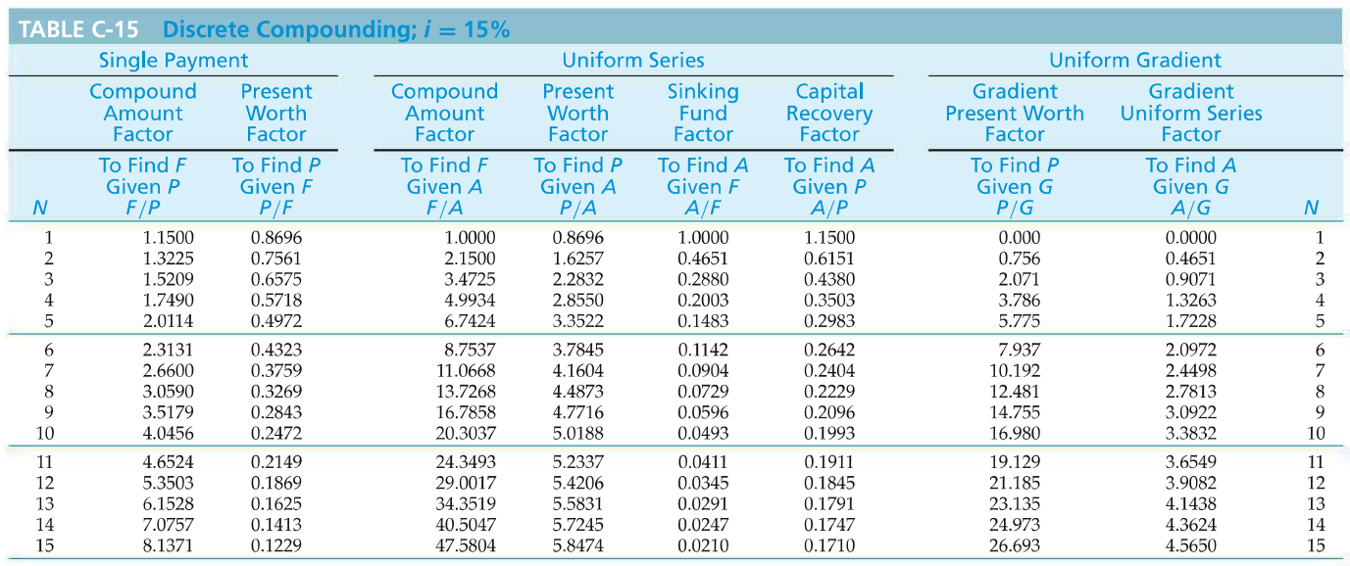

Reading Interest Table - $\left(P/A,15\%,10\right)$

Slide 6
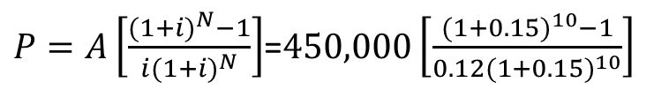




Solution Present Equivalent of an Annuity (Uniform Series)
A micro-brewery is considering the installation of a newly designed boiler system that burns the dried, spent malt and barley grains from the brewing process. The boiler will produce process steam that powers the majority of the brewery’s energy operations, saving $450,000 per year over the boiler’s expected life of 10 years. If the interest rate is 15% per year, how much money can the brewery afford to invest in the new boiler system?
$P=A$($P$/$A$, $i$%, $N$)
$=450,000$($P$/$A$, $15$%, $10$)
5.0188
$$=\$2,258,460$$
$P=A\left[\frac{{(1+i)}^{N}−1}{i{(1+i)}^{N}}\right]$=$450,000\left[\frac{{(1+0.15)}^{10}−1}{0.12{(1+0.15)}^{10}}\right]$
$$=\$2,258,460$$

Slide 7

Annuity Finding A when Given F
$F=A\left[\frac{{(1+i)}^{N}−1}{i}\right]$ → $A=F\left[\frac{i}{{(1+i)}^{N}−1}\right]$
$A=F$($A$/$F$, $i$%, $N$)

Slide 8

Annuity Finding A when Given P
$P=A\left[\frac{{(1+i)}^{N}−1}{i{(1+i)}^{N}}\right]$ → $A=P\left[\frac{i{(1+i)}^{N}}{{(1+i)}^{N}−1}\right]$
$A=P$($A$/$P$, $i$%, $N$)

Slide 9
Example Finding A when Given P
Suppose you have a $17,000 balance on your credit card. “This has got to stop!” you say to yourself. So you decide to repay the $17,000 debt in four months with equal monthly payments. An unpaid credit card balance at the beginning of a month will be charged interest at the monthly rate of 1% by your credit card company. Find the monthly payment amount.
A = $17,000(A/P, 1%, 4) = $17,000(0.2563) = $4,357.10

Slide 10
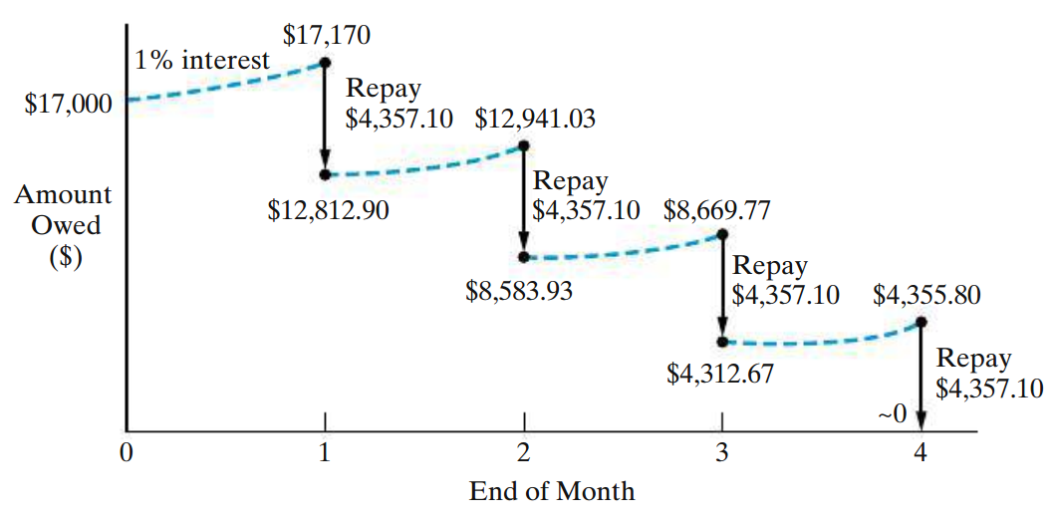
Solution Finding A when Given P

Slide 11
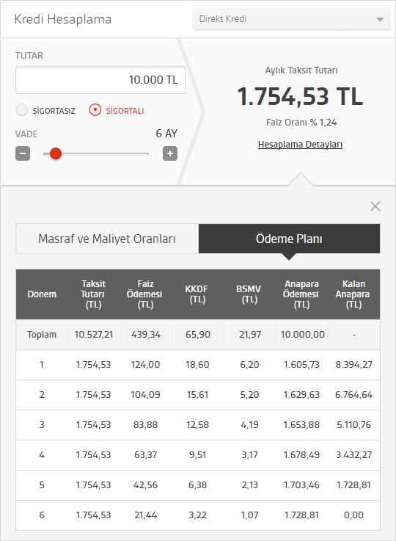

Real Life Bank Loan Payment Example
Total amount borrowed - Principal
(P = 10,000 TL)
Monthly payments
(A = 1,754.53 TL)
$$A=P\text{(}A\text{/}P\text{, }i\text{\%, }N\text{)}=P\left[\frac{i{(1+i)}^{N}}{{(1+i)}^{N}−1}\right]$$
Number of periods
(N = 6 months)
Monthly interest rate
(i = 1.488%)
Note that we have additional taxes;
BSMV (Banka Sigorta Muameleleri Vergisi): Tax rate is calculated as the 5% of the interest rate. For our example, it is 5% of the 1.24% interest rate=0.062%
KKDF (Kaynak Kullanımı Destekleme Fonu): Tax rate is calculated as the 15% of the interest rate. For our example, it is 15% of the 1.24% interest rate=0.186%
Adding those to the original interest rate, we find our final interest rate as 1.488% (1.24% + 0.062% + 0.186%)
Interest payments
Principal payments
* Please note the differences for the thousands and decimal separators as this table is taken from a Turkish bank’s website.

Slide 12
Real Life Bank Loan Payment Example
Please play around with different scenarios from different banks and most recent interest rates.

Slide 13
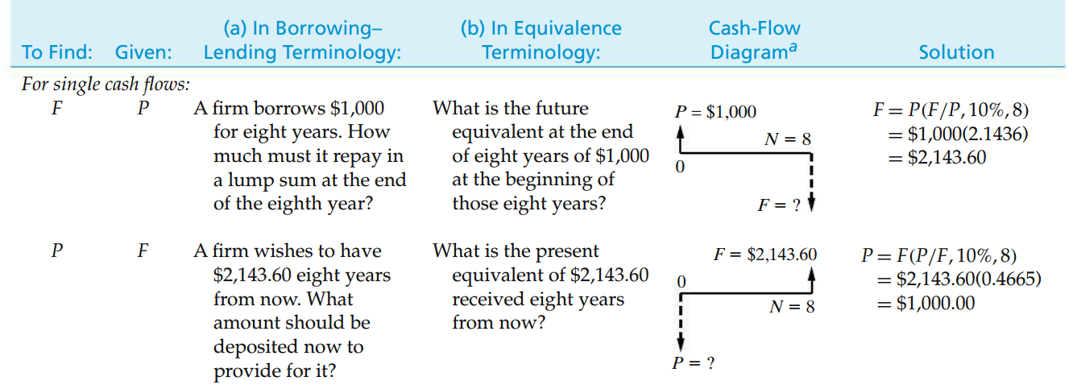
In-class Exercises

Slide 14
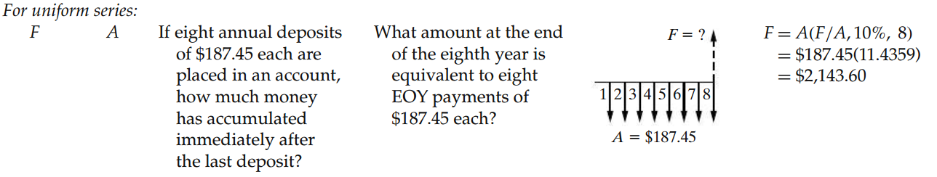
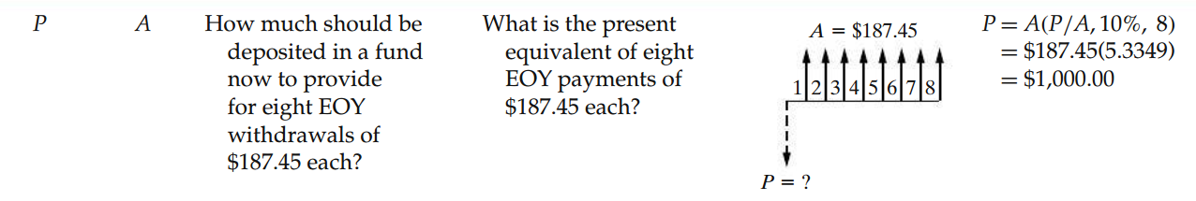
In-class Exercises

Slide 15
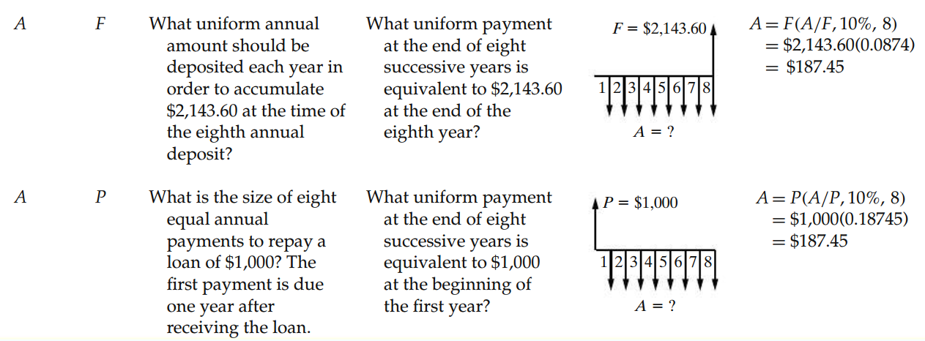
In-class Exercises

Slide 16
Finding the Number of Cash Flows in an Annuity Given A, P, and i
Sometimes we may have information about
a present amount of money (P),
the magnitude of an annuity (A), and
the interest rate (i).
The unknown factor in this case is the number of cash flows in the annuity (N).

Slide 17
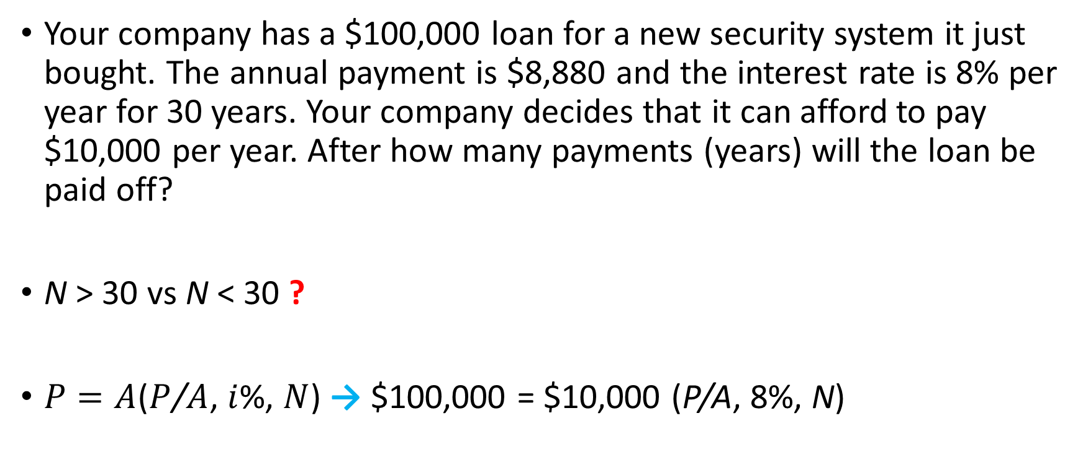
Example Prepaying a Loan − Finding N
Your company has a $100,000 loan for a new security system it just bought. The annual payment is $8,880 and the interest rate is 8% per year for 30 years. Your company decides that it can afford to pay $10,000 per year. After how many payments (years) will the loan be paid off?
N > 30 vs N < 30 ?
$P=A$($P$/$A$, $i$%, $N$) → $100,000 = $10,000 (P/A, 8%, N)
Notes:
A = $100,000 (A/P, 8%, 30) = $100,000 (0.0888) = $8,800 per year

Slide 18
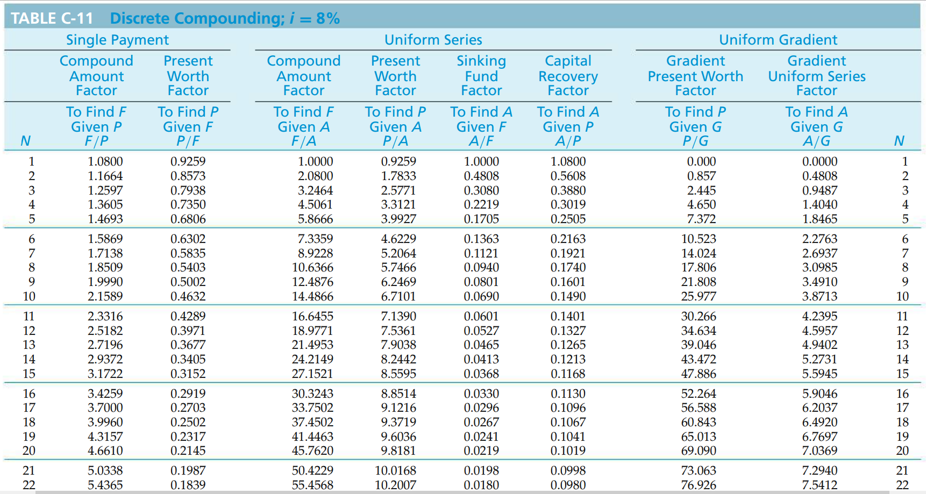
Example – Reading (P/A, 8%, N) Prepaying a Loan − Finding N
(P/A, 8%, 20) = 9.8181 and (P/A, 8%, 21) = 10.0168.
So, if $10,000 is paid per year, the loan will be paid off after 21 years instead of 30.
21st payment ?
< 10,000

Slide 19
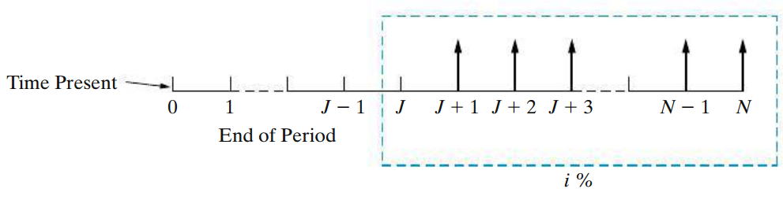
Deferred Annuities (Uniform Series) (Postponed)
All annuities (uniform series) discussed to this point involve the first cash flow being made at the end of the first period, and they are called ordinary annuities.
If the cash flow does not begin until some later date, the annuity is known as a deferred annuity.
Notes:
P0 = A(P/A, i%, N - J)(P/F, i%, J).

Slide 20
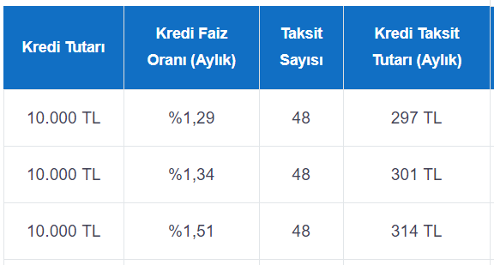

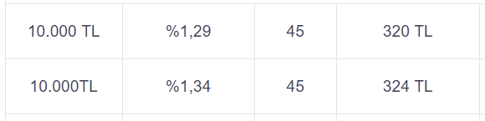
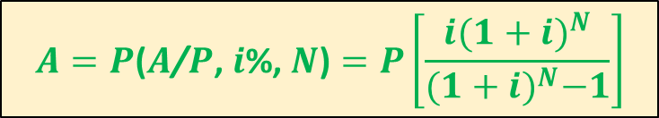
Real Life Bank Loan Payment Example Deferred (postponed) Annuity
$$A=P\text{(}A\text{/}P\text{, }i\text{\%, }N\text{)}=P\left[\frac{i{(1+i)}^{N}}{{(1+i)}^{N}−1}\right]$$
Number of periods
(N = 48 months)
Total amount borrowed - Principal
(P = 10,000 TL)
Monthly payments
(A)
Monthly interest rate
Recall
BSMV (Banka Sigorta Muameleleri Vergisi): Tax rate is calculated as the 5% of the interest rate.
KKDF (Kaynak Kullanımı Destekleme Fonu): Tax rate is calculated as the 15% of the interest rate
(deferred 3 months)
* Please note the differences for the thousands and decimal separators as this table is taken from a Turkish bank’s website.

Slide 21

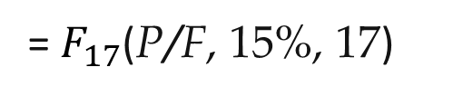



Example Present Equivalent of a Deferred Annuity
Suppose that a father, on the day his son is born, wishes to determine what lump amount would have to be paid into an account bearing interest of 15% per year to provide withdrawals of $2,000 on each of the son’s 18th, 19th, 20th, and 21st birthdays.
A = $ 2,000
$$P_{17}$$
= A(P/A, 15%, 4)
= 2,000 x 2.855
= $5,710.00
0
1
2
17
18
19
20
21
$$P_{0}$$
= $F_{17}$(P/F, 15%, 17)
$$P_{0}=?$$
$$P_{17}=F_{17}$$
= 5710 x 0.0929
= $530.46

Slide 22
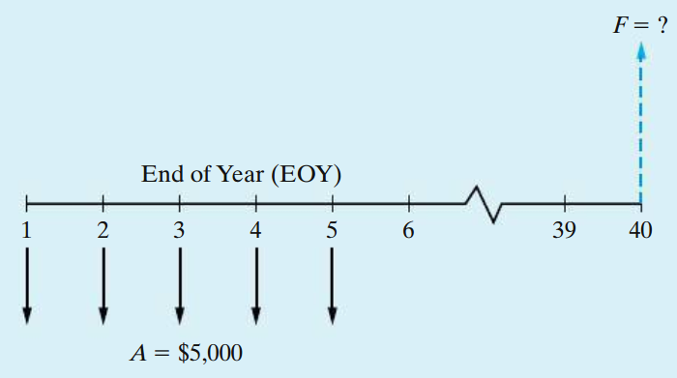
Example Deferred Future Value of an Annuity
The easiest way to approach this is to first find the future equivalent of the annuity as of time 5.
F5 = $5,000(F/A, 8%, 5) = $29,333.
To determine F40, F5 can now be denoted P5, and
F40 = P5 (F/P, 8%, 35) = $433,697

Slide 23
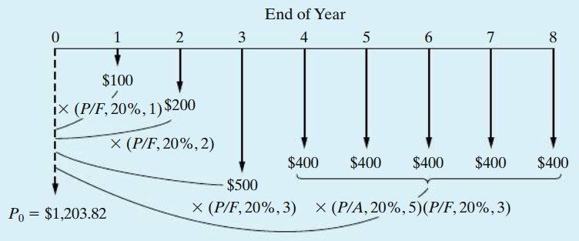
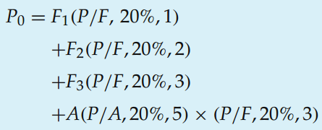
Equivalence Calculations Involving Multiple Interest Formulas
i = 20%
?

Slide 24
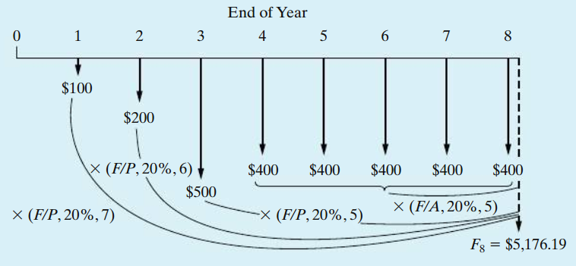
Equivalence Calculations Involving Multiple Interest Formulas (cont’d)
F8 = P0(F/P, 20%, 8) = $5,176.19
?

Slide 25
Example Determining an Unknown Annuity Amount
Two receipts of $1,000 each are desired at the EOYs 10 and 11. To make these receipts possible, four EOY annuity amounts will be deposited in a bank at EOYs 2, 3, 4, and 5. The bank’s interest rate (i) is 12% per year.
Draw a cash-flow diagram for this situation.
Determine the value of A that establishes equivalence in your cash-flow diagram.
Determine the lump-sum value at the end of year 11 of the completed cashflow diagram based on your answers to Parts (a) and (b).
Notes:
Pg 142

Slide 26
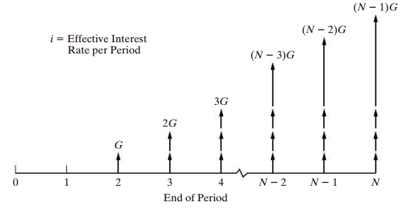
Uniform (Arithmetic) Gradient of Cash Flows

Slide 27
Uniform (Arithmetic) Gradient of Cash Flows (cont’d)
Finding P when Given G
P = G(P/G, i%, N).
Finding A when Given G
A = G(A/G, i%, N)
Be sure to notice that the direct use of gradient conversion factors applies when there is no cash flow at the end of period one.

Slide 28
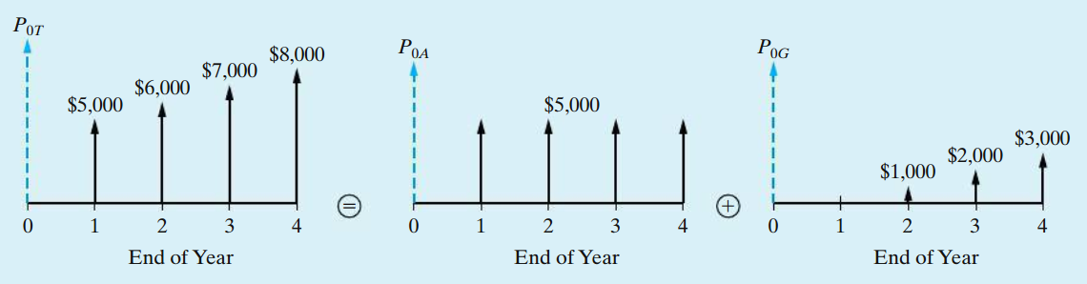
Computation Using G

Slide 29
Interest Rates that Vary with Time Example
Ashea Smith is a 22-year-old senior who used the Stafford loan program to borrow $4,000 four years ago when the interest rate was 4.06% per year. $5,000 was borrowed three years ago at 3.42%. Two years ago she borrowed $6,000 at 5.23%, and last year $7,000 was borrowed at 6.03% per year. Now she would like to consolidate her debt into a single 20-year loan with a 5% fixed annual interest rate. If Ashea makes annual payments (starting in one year) to repay her total debt, what is the amount of each payment?

Slide 30
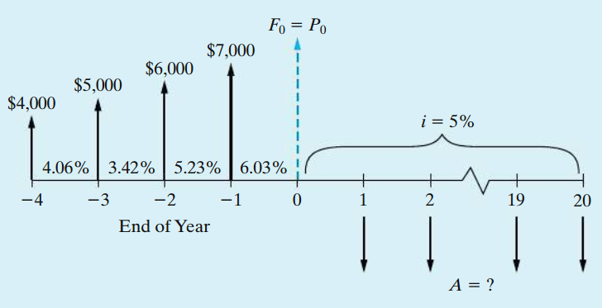
Interest Rates that Vary with Time Example (cont’d)

Slide 31
Nominal Interest Rate
Very often the interest period, or time between successive compounding, is less than one year (e.g., daily, weekly, monthly, or quarterly). It has become customary to quote interest rates on an annual basis, followed by the compounding period if different from one year in length.
“12% compounded semiannually.”
If the interest rate is 6% per interest period and the interest period is six months
The annual rate of interest is known as the nominal rate (r)
12% in this case
The actual (or effective) annual rate on the principal ?

Slide 32
Nominal Interest Rate (cont’d)
Consider a principal amount of $1,000 to be invested for three years at a nominal rate of 12% compounded semiannually.
The interest earned during the first six months would be
$1,000 × (0.12/2) = $60.
Total principal and interest at the beginning of the second six-month period is P + Pi = $1,000 + $60 = $1,060
The interest earned during the second six months would be $1,060 × (0.12/2) = $63.60.
Total interest earned during the year = $60.00 + $63.60 = $123.60

Slide 33
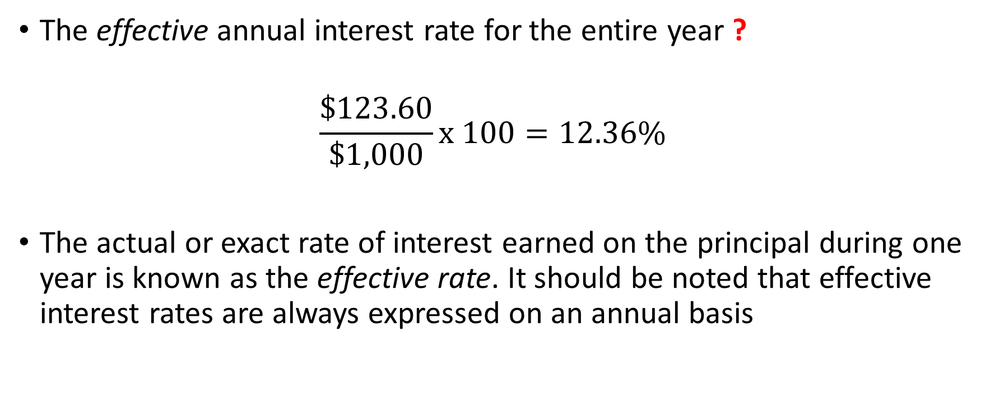
Effective Interest Rate
The effective annual interest rate for the entire year ?
$$\frac{\$123.60}{\$1,000}x 100=12.36\%$$
The actual or exact rate of interest earned on the principal during one year is known as the effective rate. It should be noted that effective interest rates are always expressed on an annual basis

Slide 34


Effective Interest Rate (cont’d)
r : nominal interest rate per year
M : the number of compounding periods per year
$i=$ ?
$${\left(1+r/M\right)}^{M}−1$$

Slide 35
Example Effective Annual Interest Rate
Monthly interest rate is 1.29 %.
What is the annual interest rate?

Slide 36
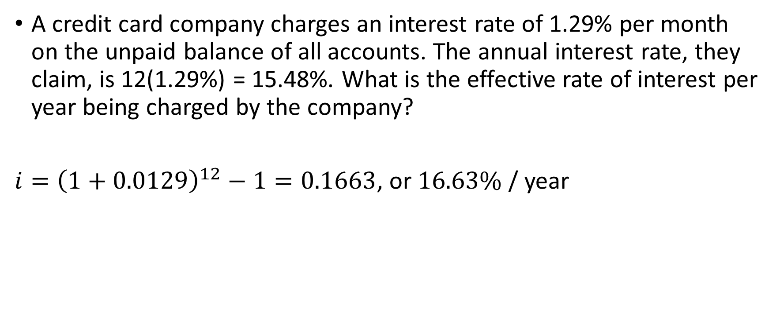
Example Effective Annual Interest Rate
A credit card company charges an interest rate of 1.29% per month on the unpaid balance of all accounts. The annual interest rate, they claim, is 12(1.29%) = 15.48%. What is the effective rate of interest per year being charged by the company?
$i={\left(1+0.0129\right)}^{12}−1=0.1663$, or $16.63\%$ / year

Slide 37
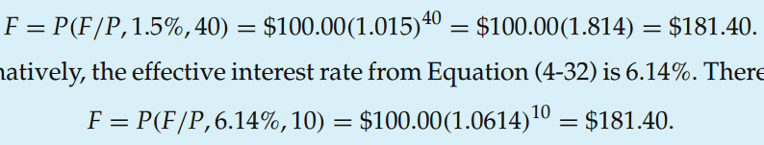
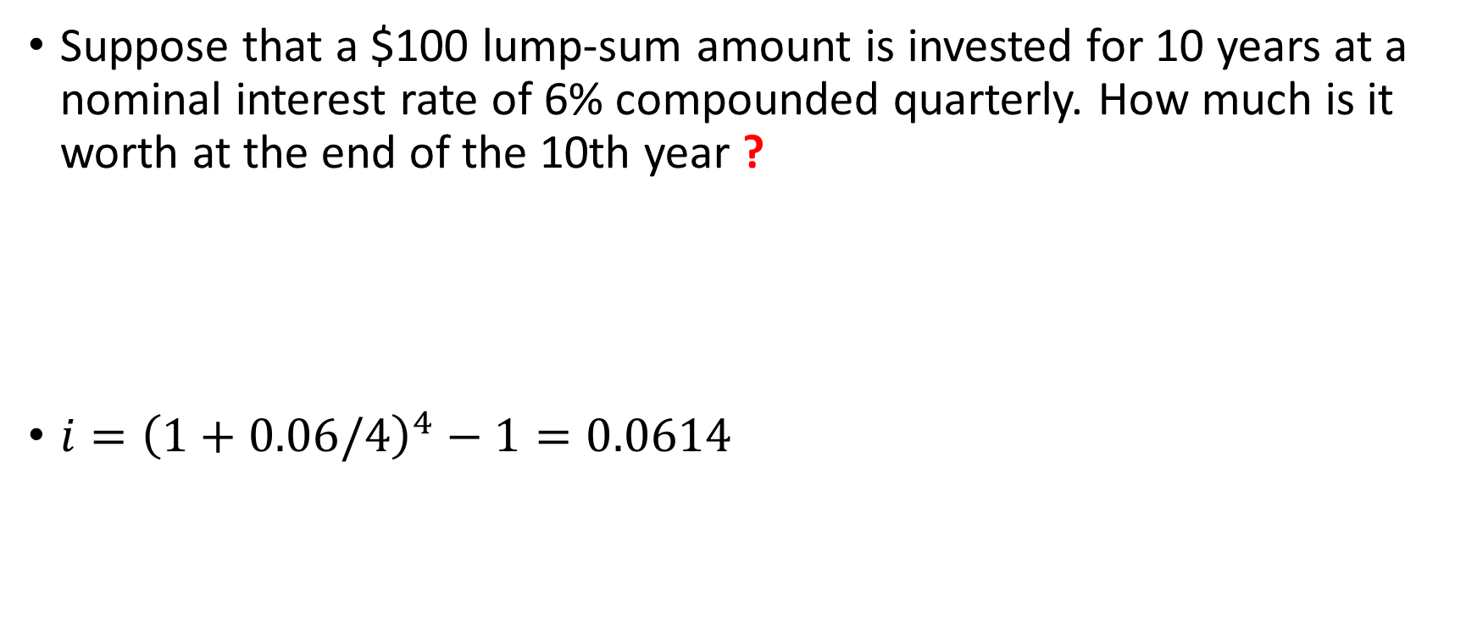
Example Future Equivalent when Interest Is Compounded Quarterly
Suppose that a $100 lump-sum amount is invested for 10 years at a nominal interest rate of 6% compounded quarterly. How much is it worth at the end of the 10th year ?
$i={\left(1+0.06/4\right)}^{4}−1=0.0614$

Slide 38
Example Uniform Gradient Series and Semiannual Compounding
Certain operating savings are expected to be 0 at the end of the first six months, to be $1,000 at the end of the second six months, and to increase by $1,000 at the end of each six-month period thereafter, for a total of four years. It is desired to find the equivalent uniform amount, A, at the end of each of the eight six-month periods if the nominal interest rate is 20% compounded semiannually.
A = G(A/G, 10%, 8) = $1,000(3.0045) = $3,004.50

Slide 39
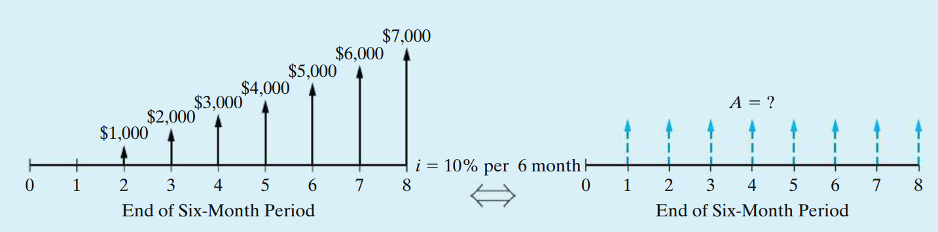
Example (cont’d) Uniform Gradient Series and Semiannual Compounding

Slide 40
End of Chapter 4

